Slide 1

E3VB Engineering Engagement Electrical Validation Board Project Proposal Presentation
January 2015
Team 12
Owners: Kris Gibbs, Brandon Towell, Luis Santiago, Travis Berger
Notes:
Brandon

Slide 2
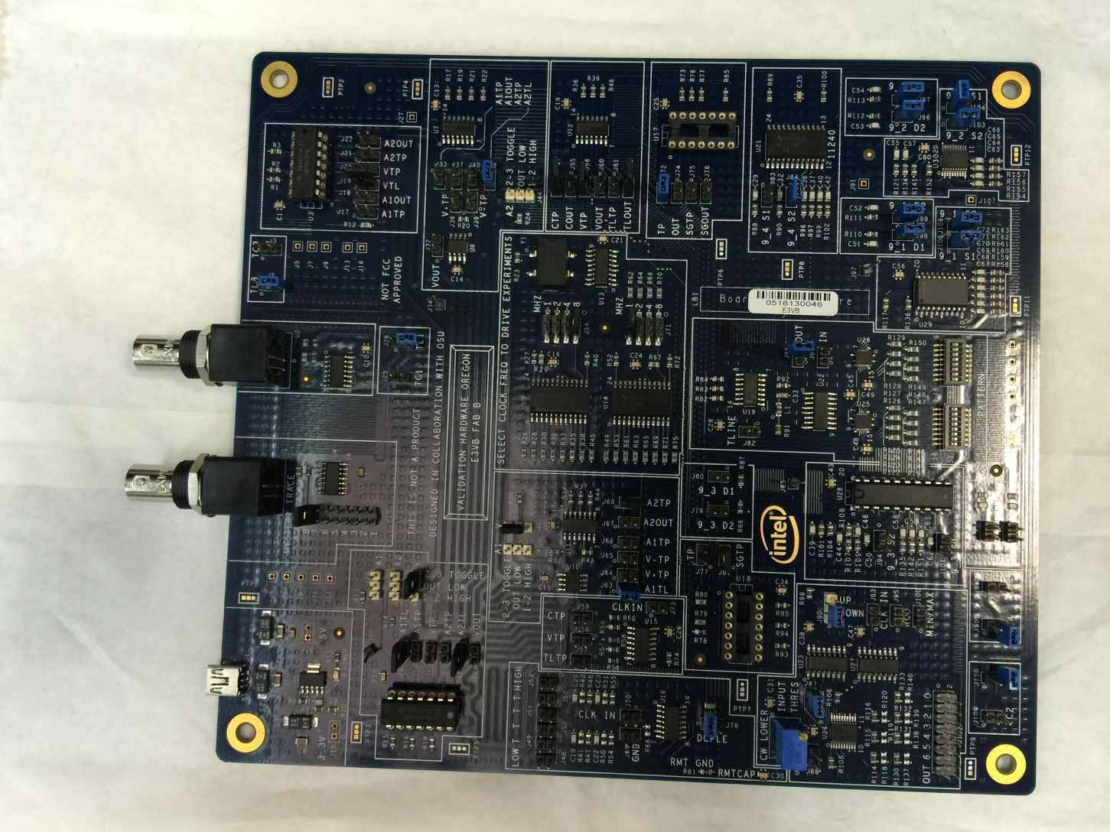
Engineering Engagement Electrical Validation Board

Slide 3
Engineering Engagement Electrical Validation Board
Developed by Intel
Teach students electrical validation concepts
Hands-on experiments
Importance of following good design practices
Notes:
Luis
developed by Intel to engage with university and help teach students electrical validation concepts. The board has ten hands-on experiments that can be conducted using a low bandwidth oscilloscope. That is usually available at most college institutions. These experiments demonstrate the importance of adhering to good design practices when laying out and routing signals on a board. The board is configurable using sockets and jumpers so that the student can see the difference in signal integrity when following or violating good design practices.

Slide 4
Existing Experiments
Crosstalk circuit I
Crosstalk circuit II
Decoupling
Corners & Vias
Mystery Traces
Simultaneous Switching Outputs
LCR Transmission Lines
Driver Circuit
Package Differences
Intersymbol Interference

Slide 5
Objective
Create a professional clear lab manual that fully utilizes the capabilities of the E3VB. Promote board to target audience of college level electrical engineering students and industry personnel who have an interest in electrical validation.
Notes:
Travis

Slide 6
Proposal Outline
Improve Project Documentation
Add Content to Board Experiments
Improve the Board Documentation
Develop a User Friendly Website
Get the Word Out About the Board
Notes:
Brandon

Slide 7
Improve Project Documentation
All documents must be formatted the same
Create both a student and instructor manual
Background theory
Make experiments as clear as possible
Improve the Board Documentation
Top down visual aids
Notes:
Travis

Slide 8
Add Content to Board Experiments
Background Theory
Bill of Materials (Equipment)
Clear Setup Procedure
Simulations
Possible Peripherals
Notes:
Travis

Slide 9
Develop a User Friendly Website
Access to all experiments
Interaction Section
Notes:
Kris
Interaction section deals with simulation only.
Access to experiments is strictly download and use offline, not to be used with control from the website or the computer.

Slide 10
Get the Word Out About the Board
Raise Board Exposure
Website
Video
Conferences
Engineering
Industrial
IEEE
Notes:
Brandon to complete and speak
Research ECTC to find value in promoting there
IEEE Signal Integratea

Slide 11
Testing
Alpha testing
Supervised user testing
Notes:
Travis to complete and speak

Slide 12
Task Breakdown
Tasks
Experiments
Website Development
Promotion
Testing
Notes:
Kris

Slide 13
Kris
Experiments
Package Differences
Simultaneous Switching Outputs
Crosstalk I & II
Website Development
Hosting
Learning Language
Writing Code
Notes:
Luis

Slide 14
Luis
Experiments
Intersymbol Interference
Driver Circuit
Crosstalk I & II
Website Development
Support Kris
Notes:
Luis

Slide 15
Travis
Experiments
LCR Transmission Lines
Corners & Vias
Crosstalk I & II
Promotional
Investigate Promotional Avenues
Investigate Best Promotional Medium
Create Promotional Project and Deliver Across Promotional Avenue
Notes:
Brandon

Slide 16
Brandon
Experiments
Mystery Traces
Decoupling
Crosstalk I & II
Promotional
Investigate Promotional Avenues
Investigate Best Promotional Medium
Create Promotional Project and Deliver Across Promotional Avenue
Notes:
Brandon

Slide 17
Timeline
Experiments Completion
Preliminary Student Version: End of February
Final Including Instructor Version: End of March
Website Completion
Mid May – End of May
Promotion Completion
Mid May
Poster Presentation
Mid May
Notes:
Travis

